Slide 1
CSU Australian English Speech Screener

Slide 2

Fish

Slide 3
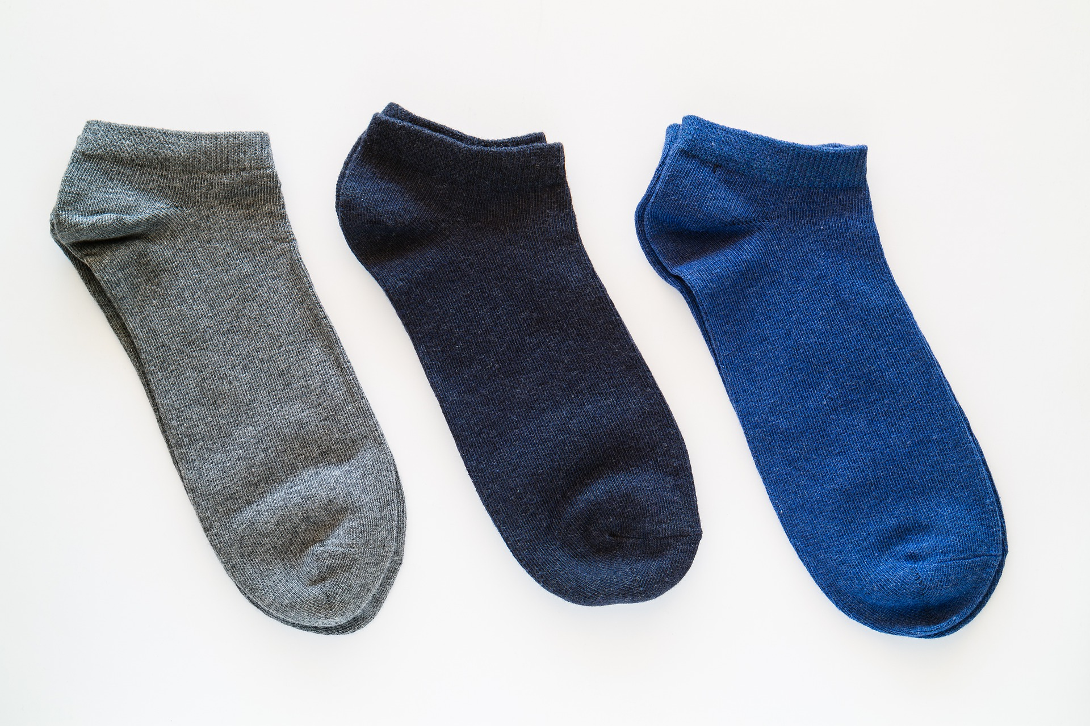
Socks

Slide 4
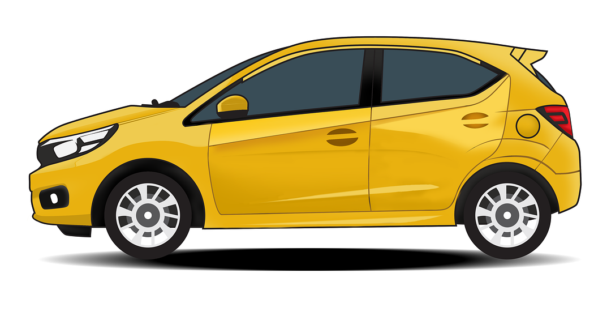
Car

Slide 5
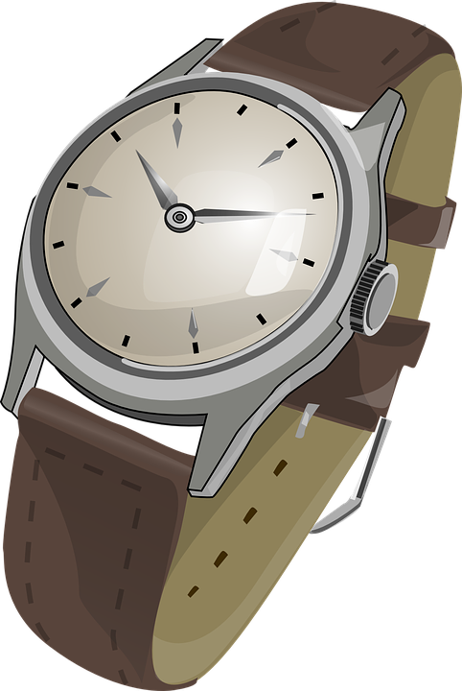
Watch

Slide 6
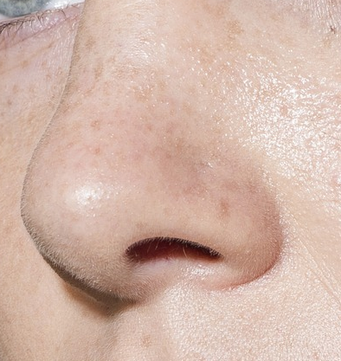
Nose

Slide 7
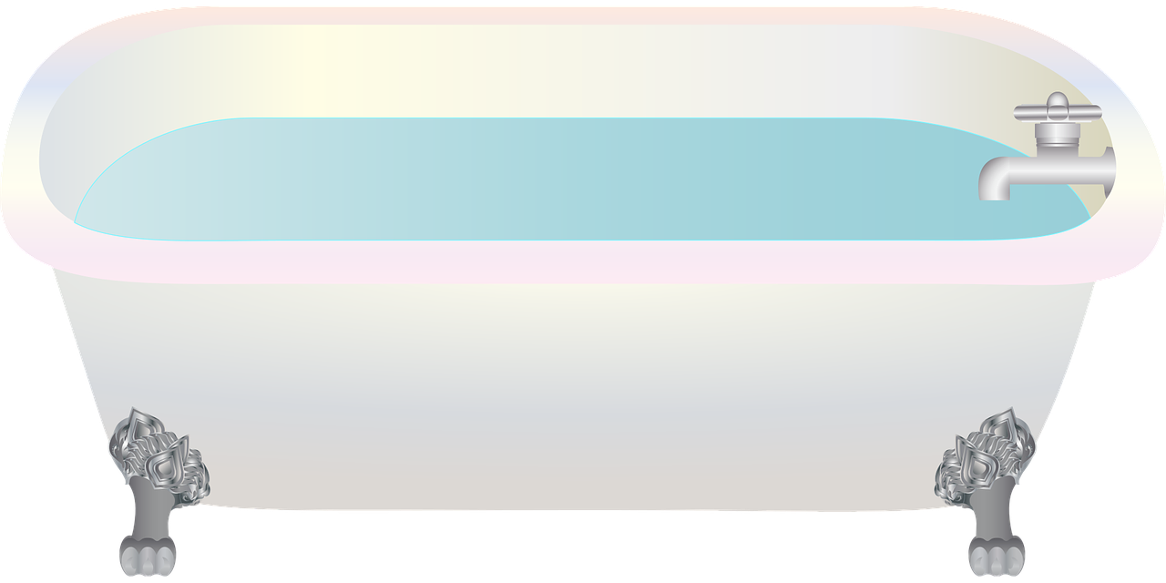
Bath

Slide 8

Leaf

Slide 9

Umbrella

Slide 10

Thumb

Slide 11

Books

Slide 12

Snake

Slide 13

Girl

Slide 14
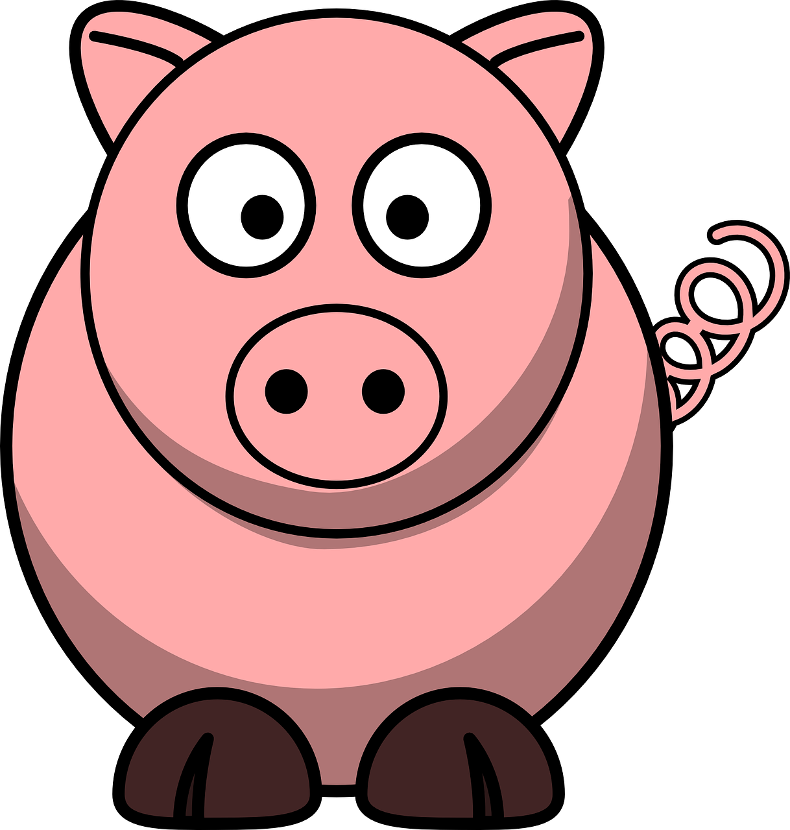
Pig

Slide 15
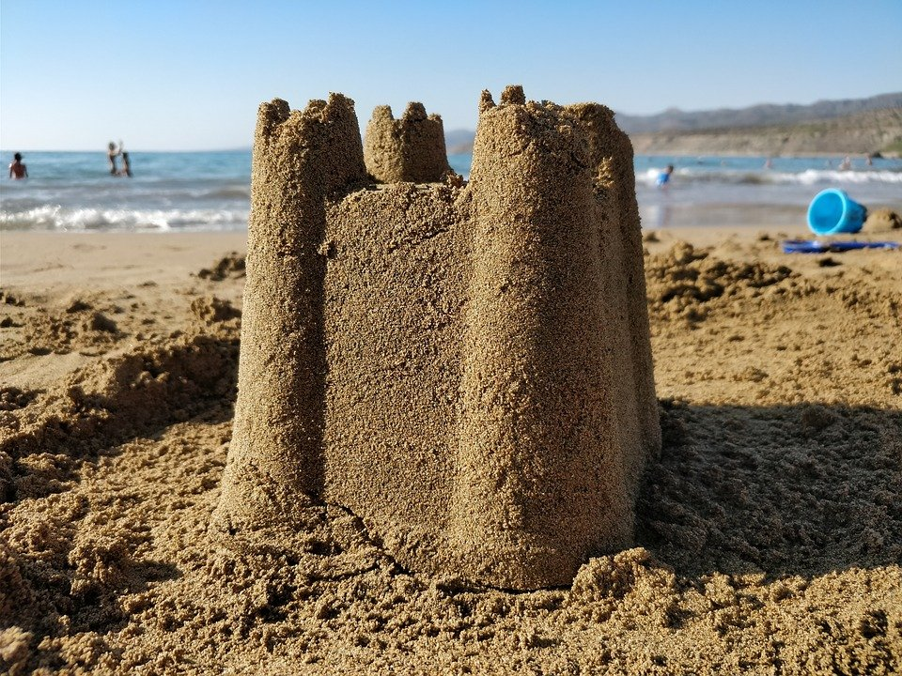
Sand

Slide 16

House

Slide 17
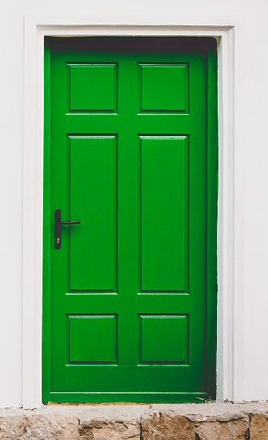
Door

Slide 18
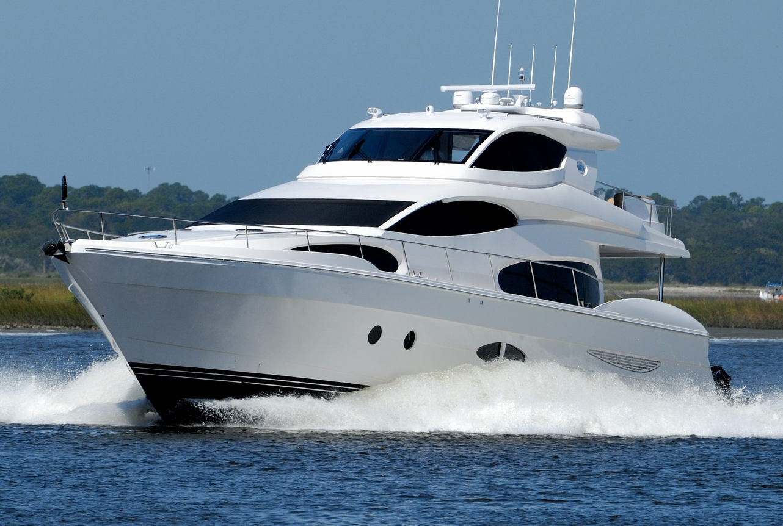
Boat

Slide 19
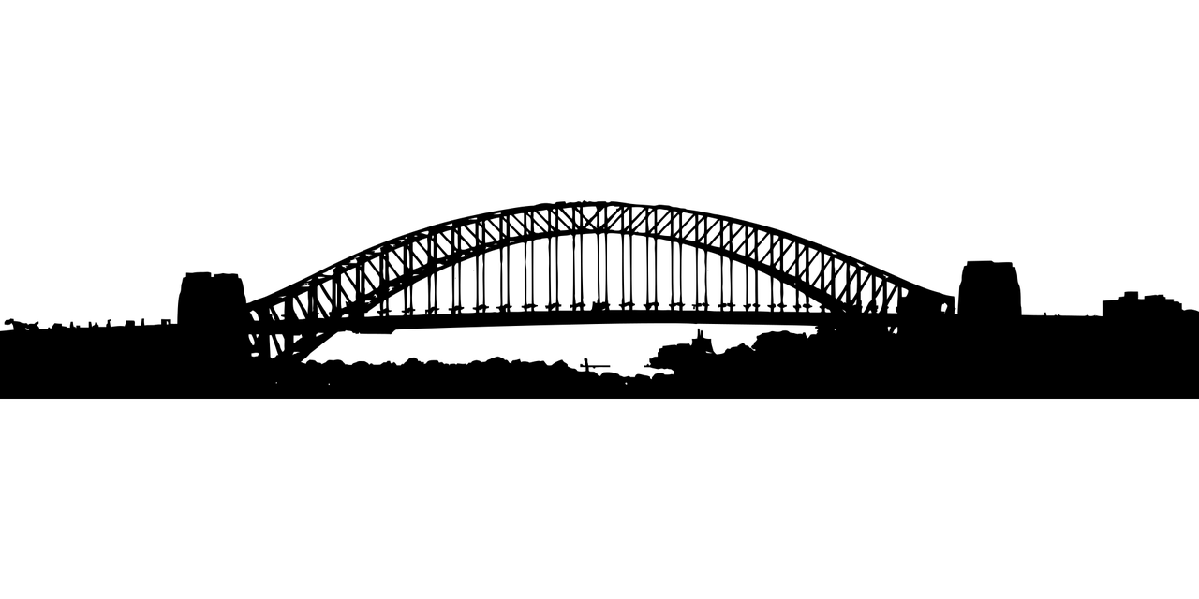
Bridge

Slide 20
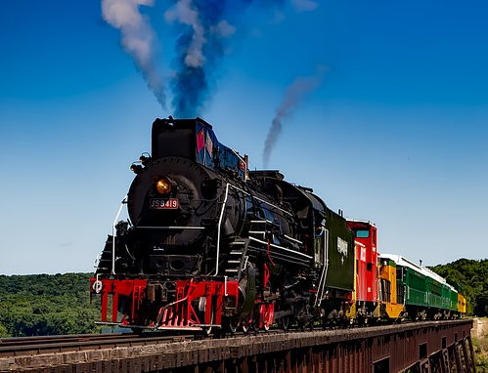
Train

Slide 21
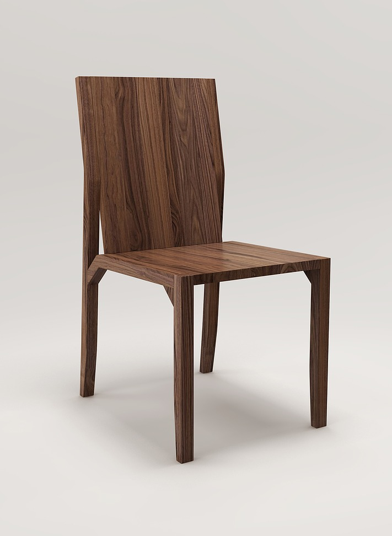
Chair

Slide 22
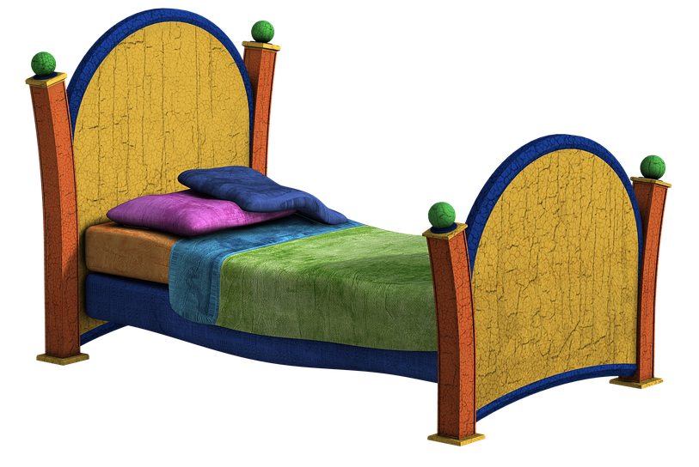
Bed

Slide 23
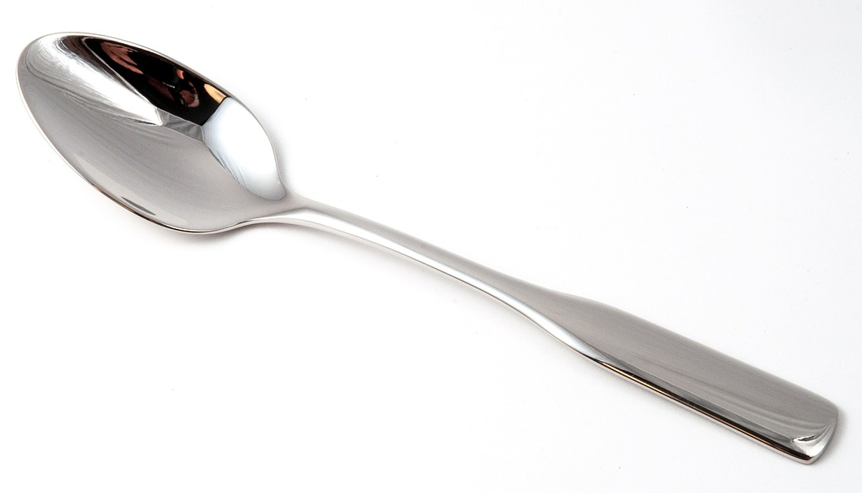
Spoon

Slide 24
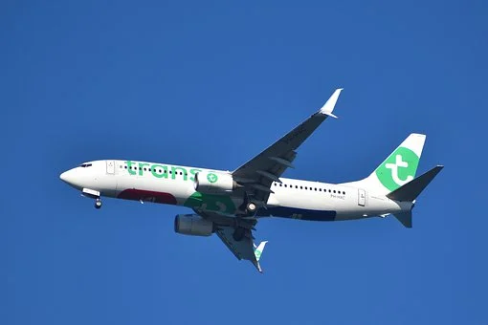
Plane

Slide 25
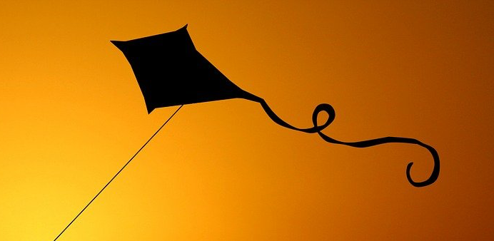
Kite

Slide 26
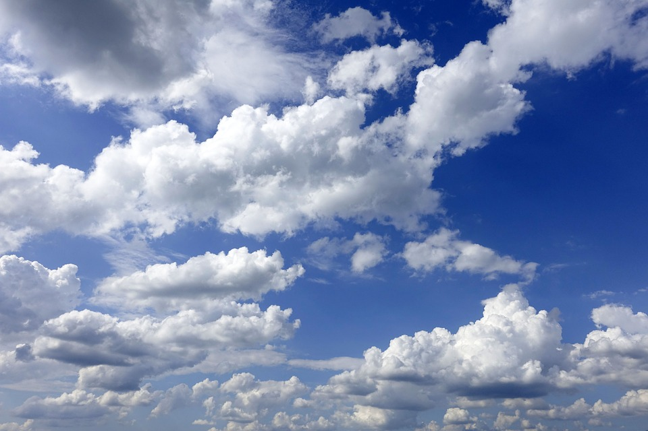
Sky

Slide 27

Sun

Slide 28

Ring

Slide 29

Hat

Slide 30
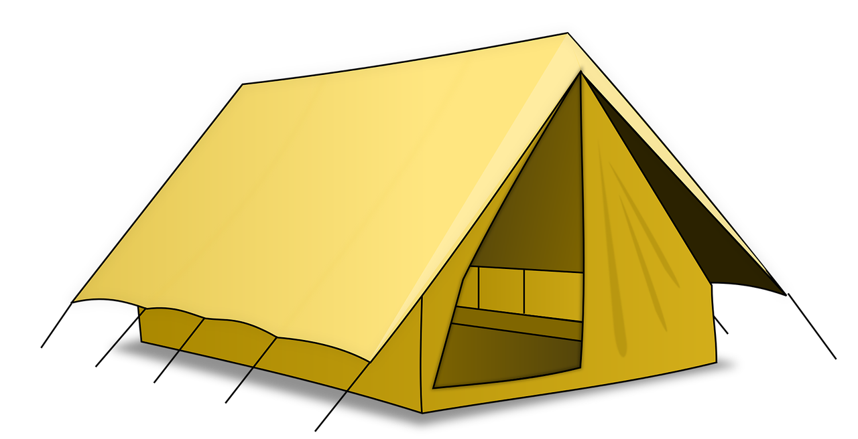
Tent

Slide 31

Crab

Slide 32
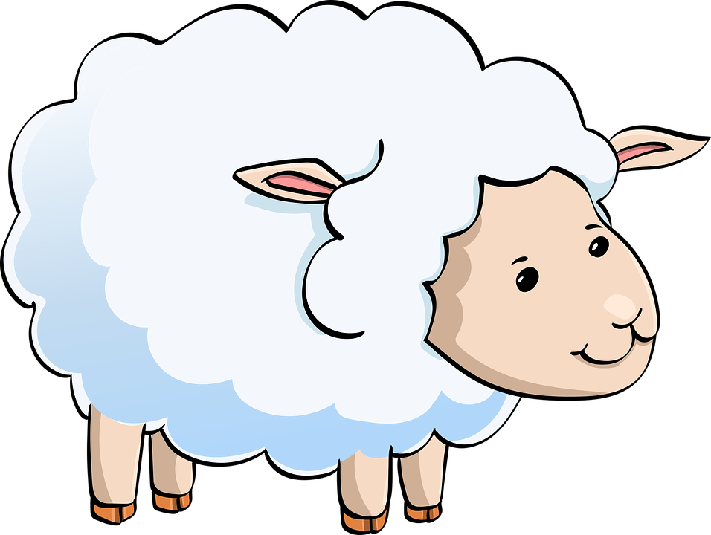
Sheep

Slide 33
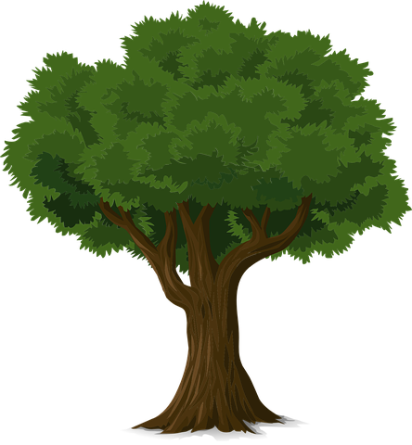
Tree

Slide 34
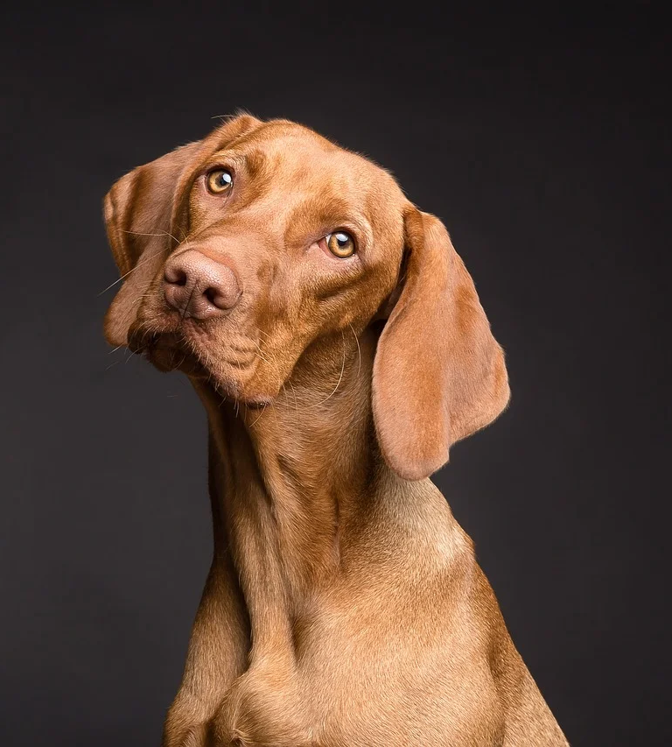
Dog

Slide 35
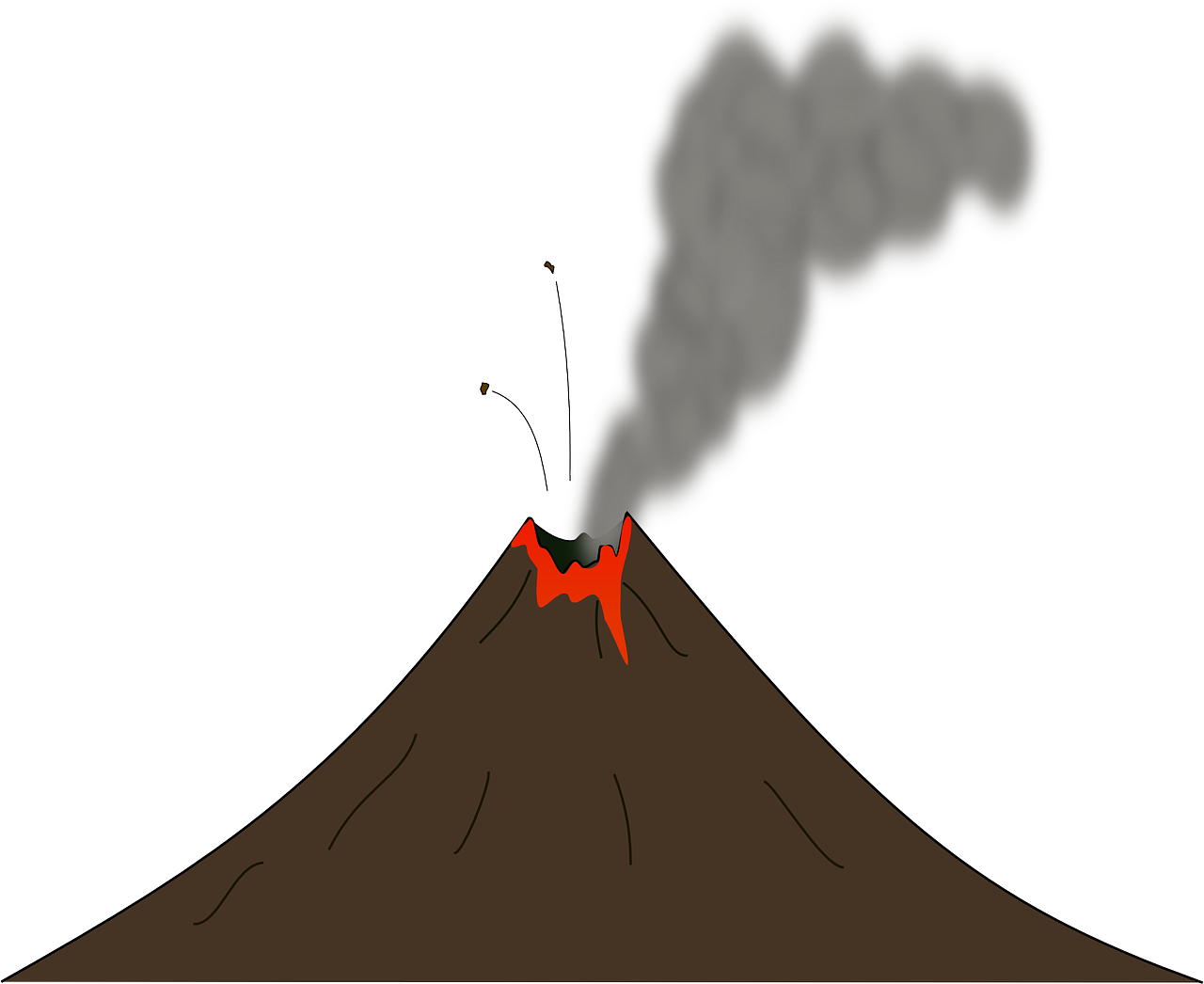
Volcano

Slide 36
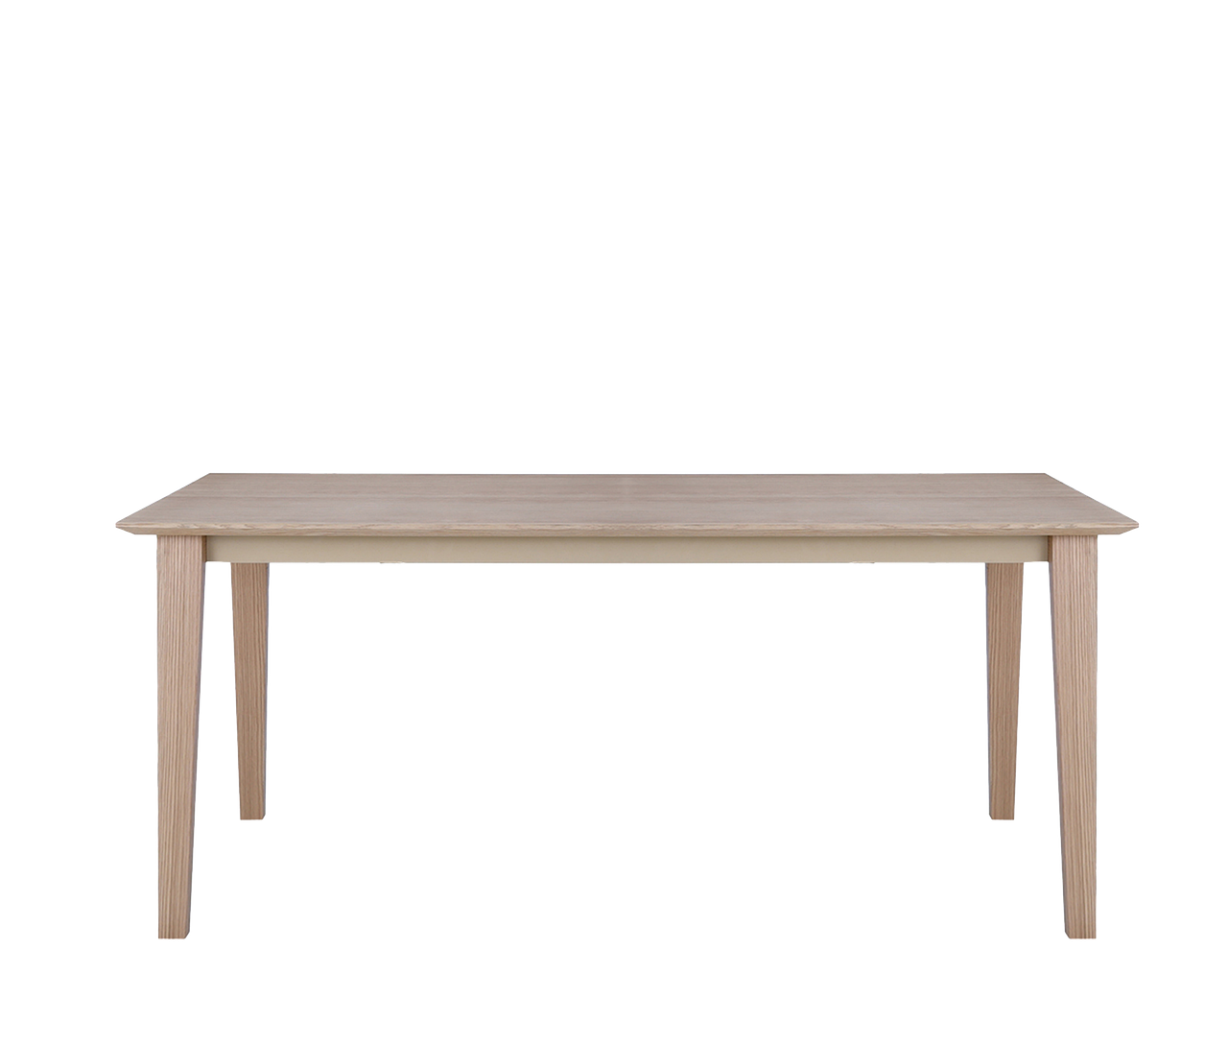
Table

Slide 37
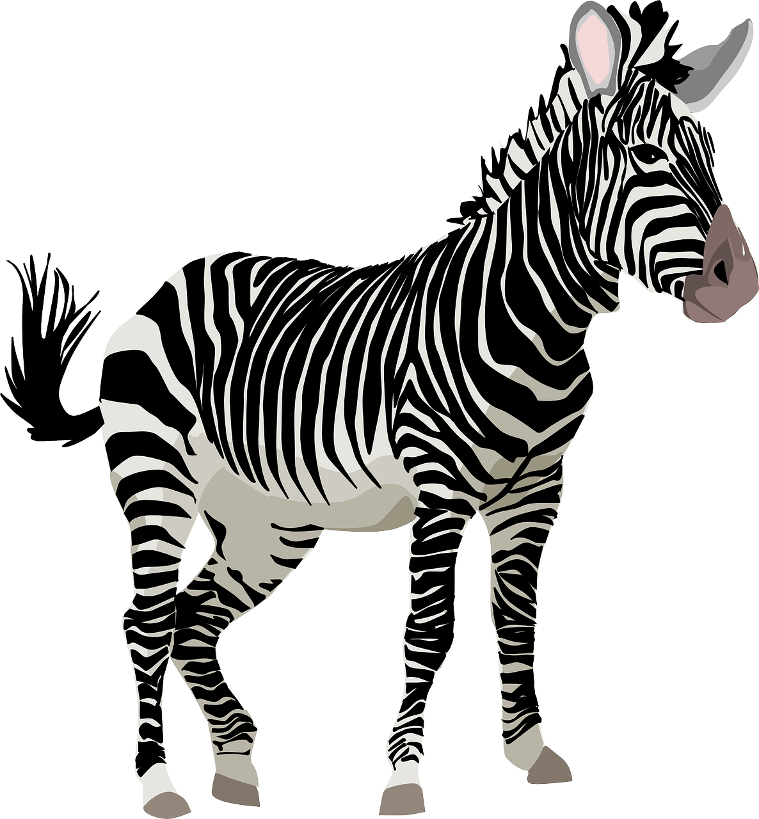
Zebra

Slide 38
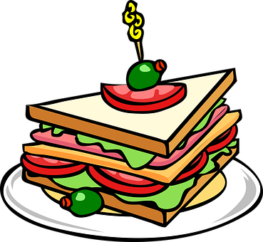
Sandwich

Slide 39
Yellow

Slide 40
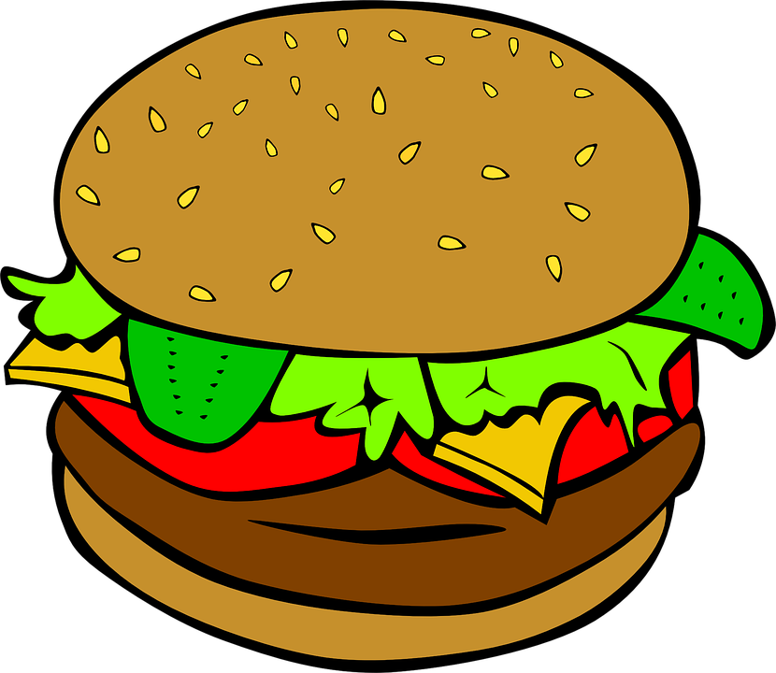
Burger

Slide 41

Window

Slide 42
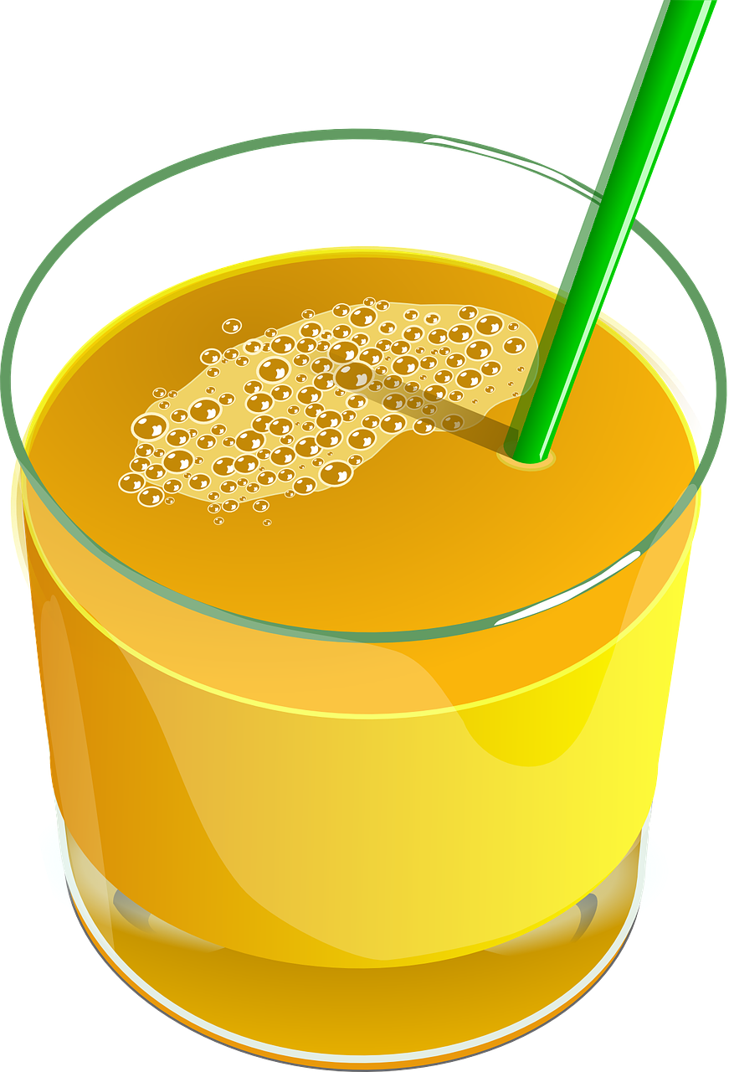
Juice

Slide 43

Elephant

Slide 44
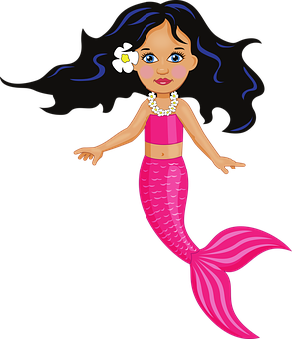
Mermaid

Slide 45

Apple

Slide 46
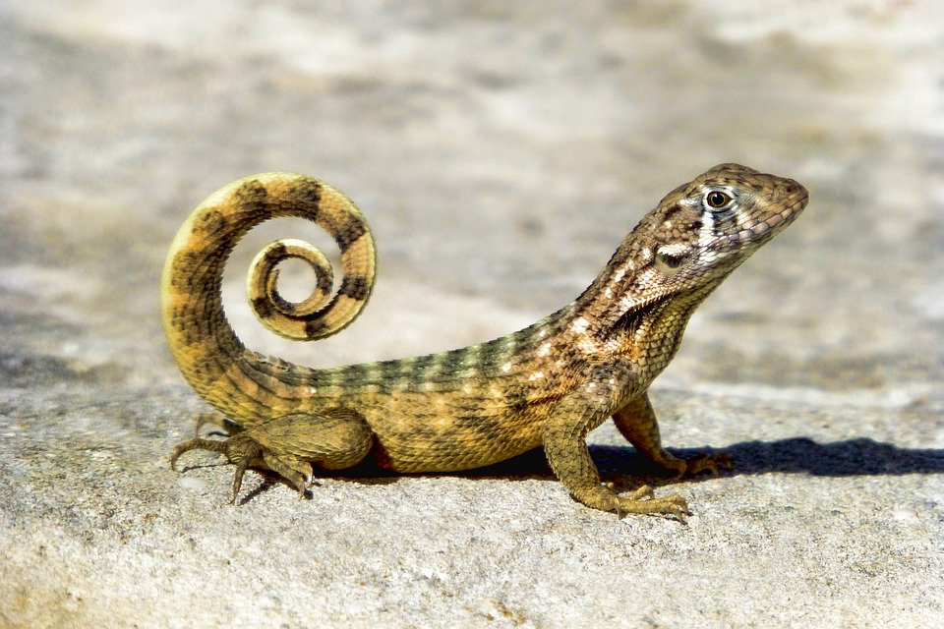
Lizard

Slide 47
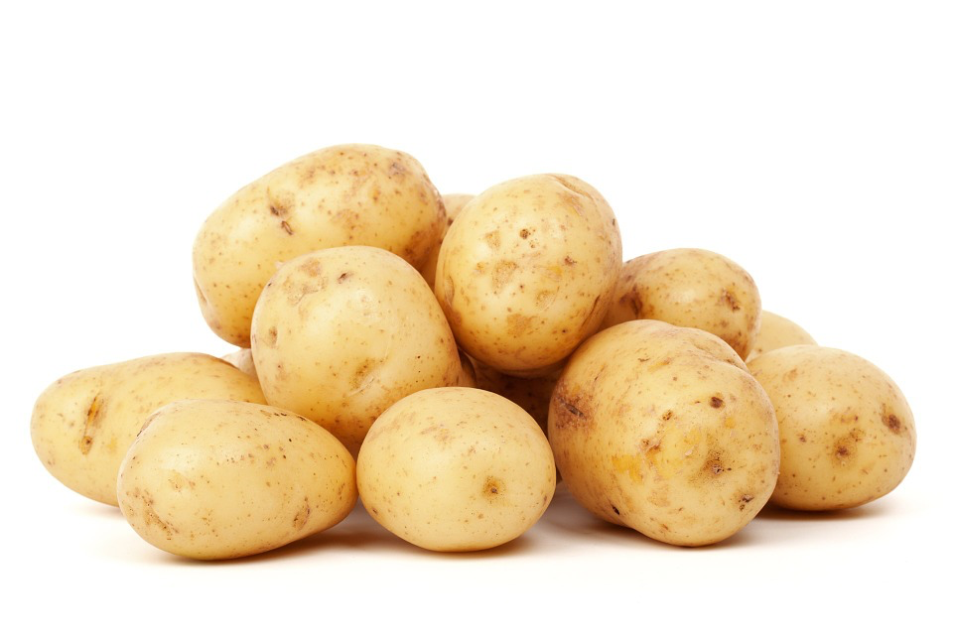
Potatoes

Slide 48
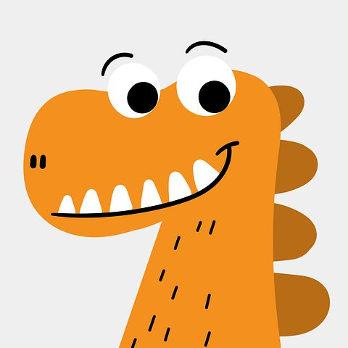
Dinosaur

Slide 49
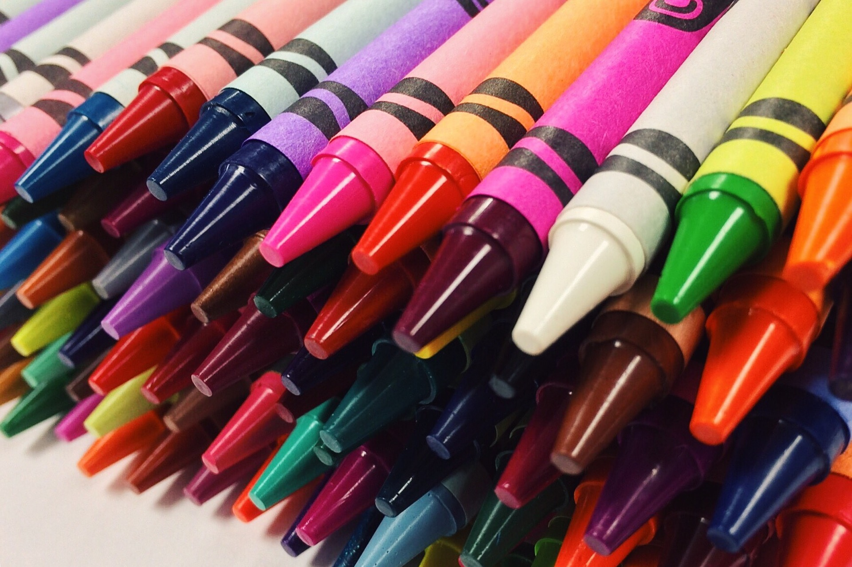
Crayons

Slide 50
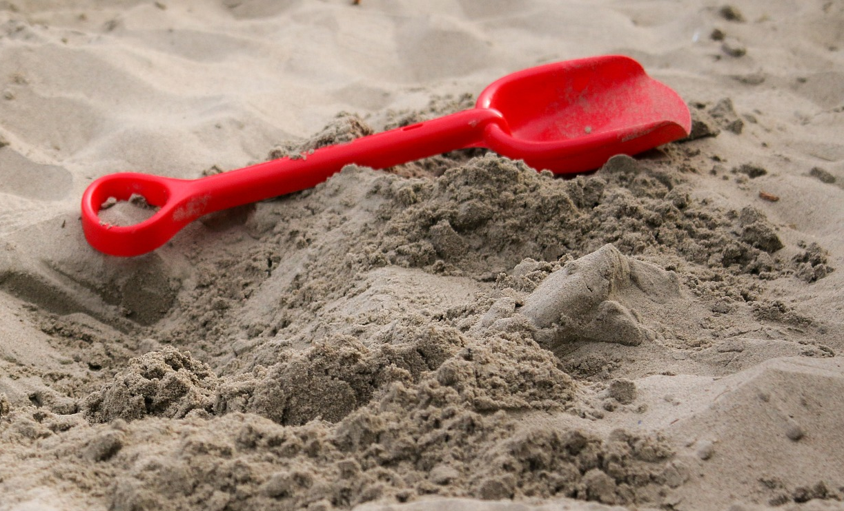
Shovel

Slide 51
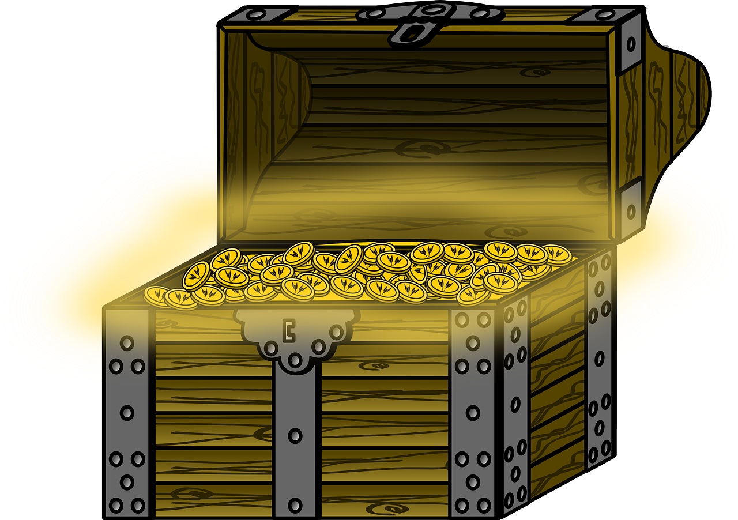
Treasure

Slide 52
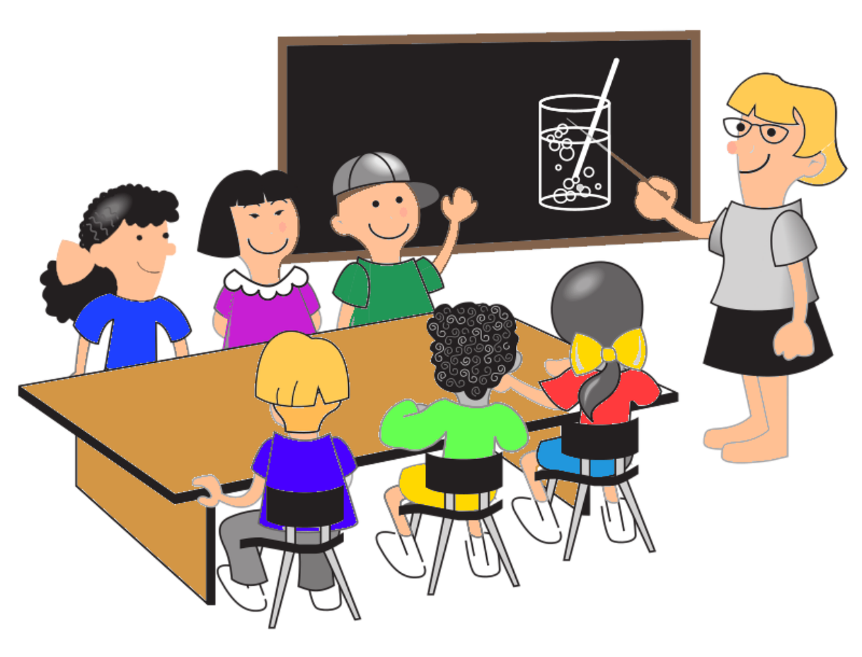
Teacher

Slide 53
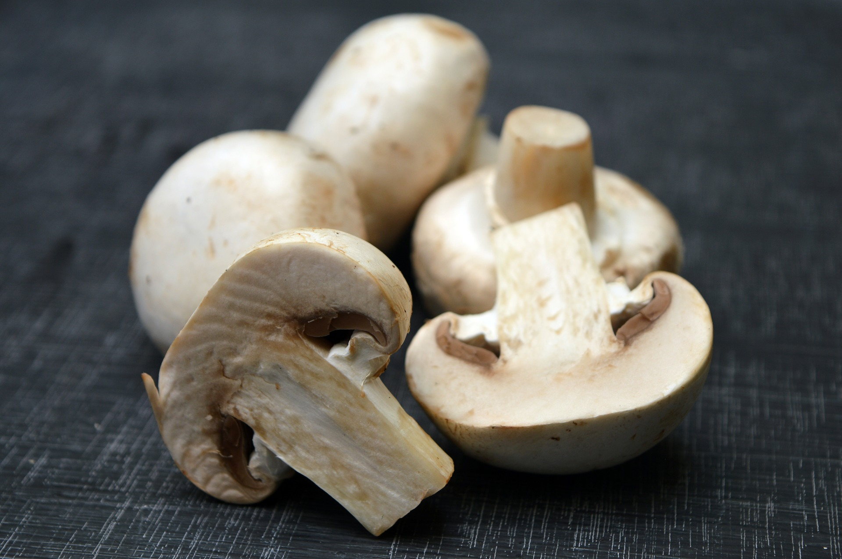
Mushrooms

Slide 54
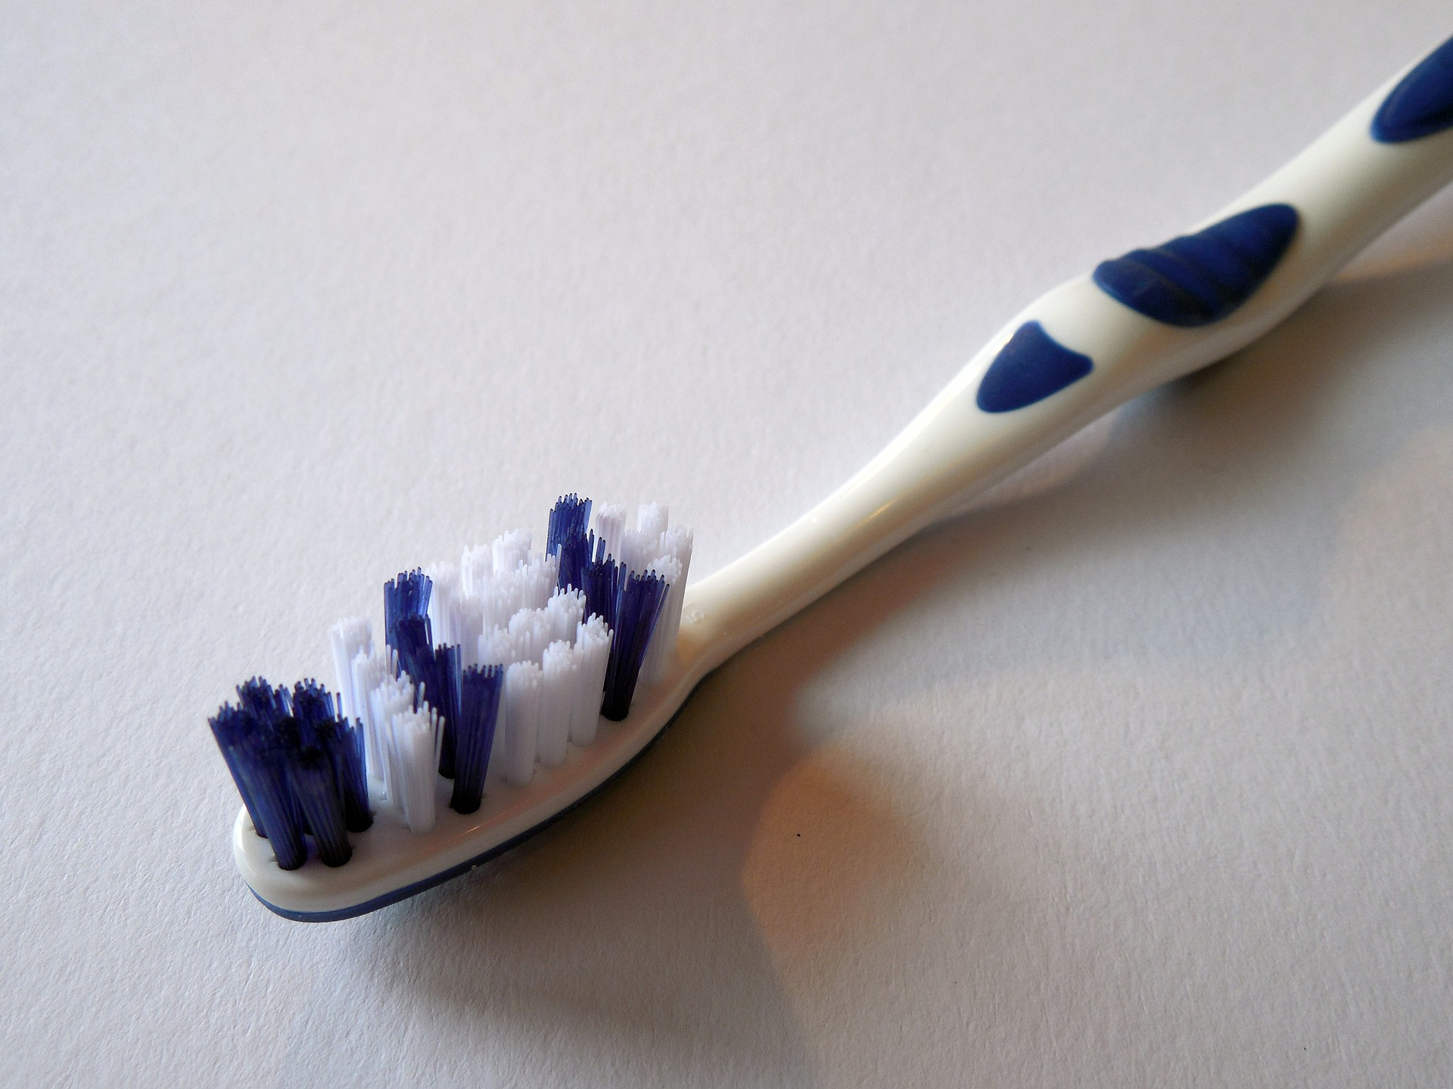
Toothbrush

Slide 55
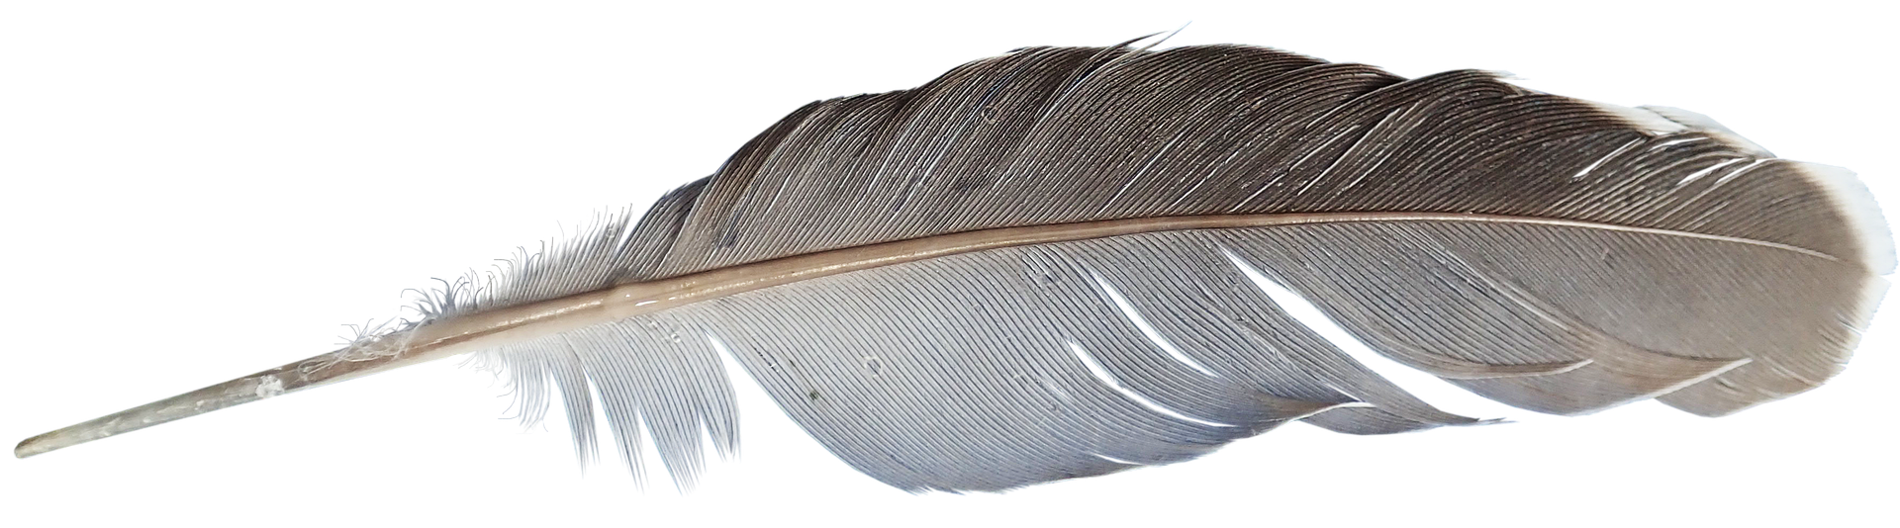
Feather

Slide 56
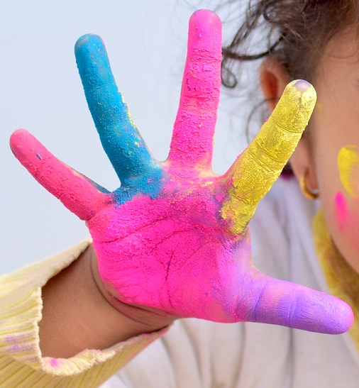
Fingers

